Slide 1
Capstone project
Supply Chain Analytics
SMDM Project Business Report DSBA
Sanjay Srinivasan
PGP-DSBA Online
JULY’ 21 Batch
Date: 24-06-2022

Slide 2
Business Problem Understanding
Problem Statement:
A FMCG company has entered into the instant noodles business two years back. Their higher management has notice that there is a miss match in the demand and supply. Where the demand is high, supply is pretty low and where the demand is low, supply is pretty high. In both the ways it is an inventory cost loss to the company; hence, the higher management wants to optimize the supply quantity in each and every warehouse in entire country.

Slide 3
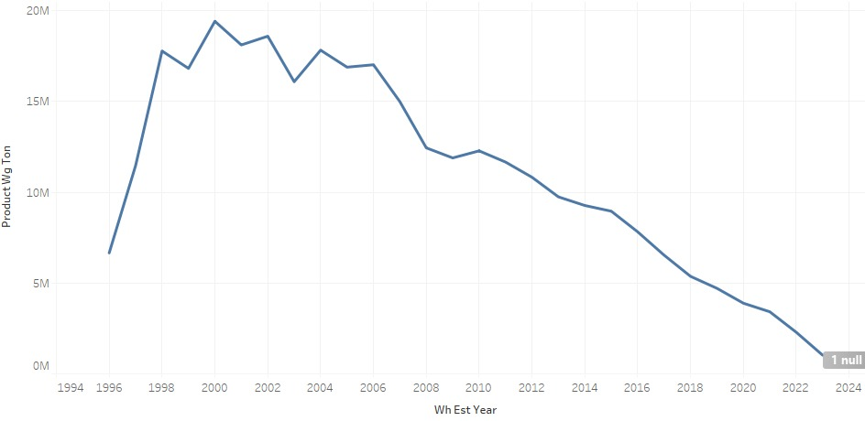
EDA Insights
This dataset has 25000 rows of data with 22 independent variable and 1 dependent variable.
Product_wg_ton is the dependent variable.
The products have been shipped to warehouses across years is plotted.

Slide 4
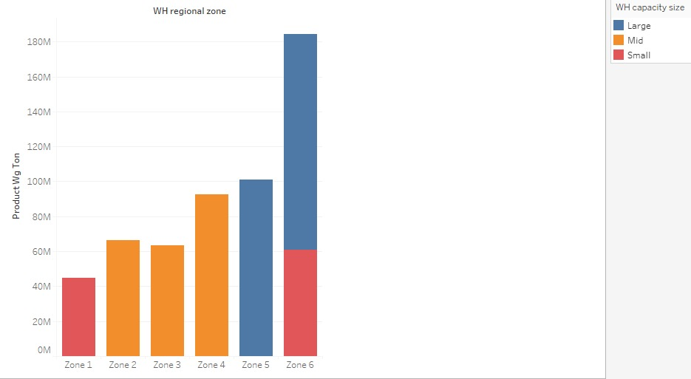
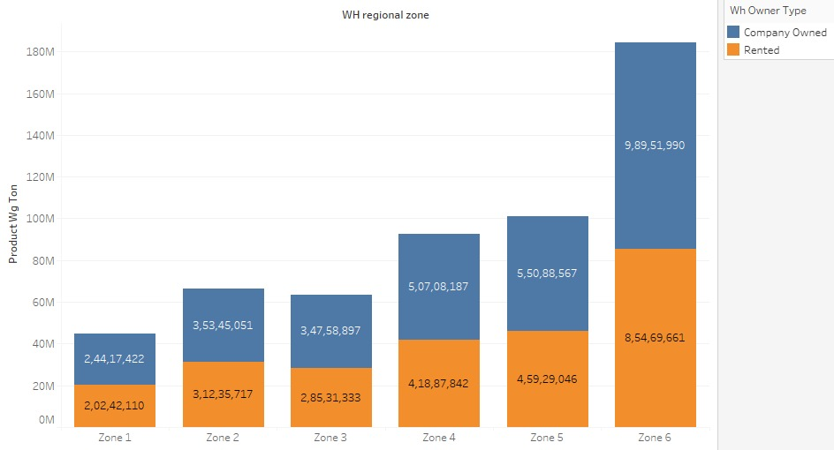
EDA Insights

Slide 5
Business Problem Understanding
To find the mismatch in demand and supply so that management can optimize the supply quantity in each and every warehouse in entire country.
The optimum weight of the product shipped every time based on the demand on each zone or region.
Data analysis will help us to analysis the product quantity sale based on the zone wise demand.
Loss can be minimized by the management based on data analysis.
There are three main types of constraints to consider when developing a feasible supply chain plan are
Production Constraints,
Flow Constraints
Storage Constraints.

Slide 6
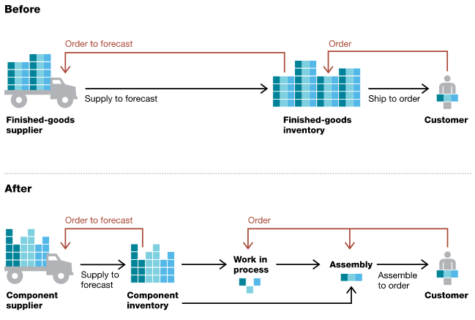
Supply Chain Management

Slide 7
Business Problem Understanding
To meet demand and supply:
Promotion of products through advertisements in low demanding zone.
Minimum inventory is based on ROP (Reorder product) and ROQ (Reorder Quantity)
New marketing strategies to be implemented based on low and high demand of product zone. Marketing strategies are:
Posters
Pamphlets
Offers
Sign Boards
Health benefits of the product

Slide 8
Business Problem Understanding
Understanding business/ social opportunity:
The demand patterns of the customers across different zones can help the company in understanding the customer behaviour and needs of the customer in every zone.
By this, we can forecast the demand of the products in every zone and needed quantity can be shipped to every dealer/ retailer based on the demand in every zone (Resources in demand & shipping of the product).
The company can monitor the performance of the goods/product in every zone and offers based on low and high selling zone.
The optimum maintenance and cash margin can be given based on the demand of the product in every zone.
Based on the demand of the product, the stocks can be refilled in the warehouses in every zone.
Rotation of Stocks regularly helps the company to reduce the loss, improves the efficiency and product demand can be improved.
This helps the business to optimize the performance.

Slide 9
Modeling approach used & why
Model building can be done in two ways:
Model building without hyper parameter tuning.
Model building with hyper parameter tuning.
Model building without hyper parameter tuning:
Linear Regression
Artificial Neural Network (ANN)
Ridge Regression
Model building with hyper parameter tuning:
Model used:
Random Forest Regression
Gradient boosting Regression
Ridge Regression
Tuning Method:
Randomized search CV
Grid search CV

Slide 10
Modeling approach used & why
Linear Regression
Linear Regression is simple to implement and easier to interpret the output coefficients.
Less complexity model when independent and dependent variable has linear relationship.
Parameters used in linear regression:
n_jobs = -1
Parameters calculated in linear regression and value are:
Mean squared Error (MSE) - 0.782141
Mean Absolute Percent Error (MAPE) - 1.500963
Mean Absolute Error (MAE) - 0.735799
Root Mean Squared Error (RMSE) - 0.884387
R-Squared value (R2 value) - 0.212583

Slide 11
Modeling approach used & why
Artificial Neural Network (ANN)
Storing information on the entire network
Having a distributed memory
Parallel processing capability
Parameters used in ANN regression:
hidden_layer_sizes=(100)
activation='relu'
solver='adam'
alpha=0.00001
random_state=42
tol=0.000001
Parameters calculated in ANN regression and value are:
Mean squared Error (MSE) - 0.829731
Mean Absolute Percent Error (MAPE) - 1.684118
Mean Absolute Error (MAE) - 0.734295
Root Mean Squared Error (RMSE) - 0.910896
R-Squared value (R2 value) - 0.164672

Slide 12
Modeling approach used & why
Ridge Regression (L2 Regularization)
Avoids overfitting model
Performs well in large multivariate data.
Parameters used in ridge regression:
tol=0.0001
Random_state = 42
Parameters calculated in Ridge regression and value are:
Mean squared Error (MSE) - 0.781966
Mean Absolute Percent Error (MAPE) - 1.500014
Mean Absolute Error (MAE) - 0.735692
Root Mean Squared Error (RMSE) - 0.884289
R-Squared value (R2 value) - 0.212759

Slide 13
Modeling approach used & why
Random Forest Regression
It reduces overfitting in decision trees and helps to improve the accuracy
It is flexible to both classification and regression problems
It works well with both categorical and continuous value.
Parameters used in random forest regression with hyper parameter tuning:
‘max_depth': [20, 40, 60, 80, 100, 120],
'max_features': ['auto', 'sqrt'],
'min_samples_leaf': [1, 2, 4],
'min_samples_split': [2, 5, 10],
'n_estimators': [150, 200, 250]
Best parameter of random forest regressor model is:
'n_estimators': 200,
'min_samples_split': 10,
'min_samples_leaf': 4,
'max_features': 'sqrt',
'max_depth': 60
Parameters calculated in random forest and value are:
Mean squared Error (MSE) - 0.707342
Mean Absolute Percent Error (MAPE) - 1.284933
Mean Absolute Error (MAE) - 0.683958
Root Mean Squared Error (RMSE) - 0.841036
R-Squared value (R2 value) - 0.290073

Slide 14
Modeling approach used & why
Gradient boosting Regression
Better accuracy
Less pre-processing time
Higher flexibility
Parameters used in Gradient boosting regression with hyper parameter tuning:
'n_estimators': [100, 200, 500, 1000],
'learning_rate': [10, 20, 30, 50],
'loss': ['linear', 'square', 'exponential']
Best parameter of Gradient boosting regressor model is:
'n_estimators': 500,
'loss': 'exponential',
'learning_rate': 10
Parameters calculated in Gradient boosting and value are:
Mean squared Error (MSE) - 0.968798
Mean Absolute Percent Error (MAPE) - 1.108949
Mean Absolute Error (MAE) - 0.807004
Root Mean Squared Error (RMSE) - 0.984275
R-Squared value (R2 value) - 0.024667

Slide 15
Modeling approach used & why
Ridge Regression
Better accuracy
Less pre-processing time
Higher flexibility
Parameters used in random forest regression with hyper parameter tuning:
'Alpha':[1e-15,1e-10,1e-8,1e-3,1e-2,1,5,10,20,30,35,40,45,50,55,100],
'Random_state':[42,273,450,236,970],
'tol':[0.001,0.0001],
'solver':['auto','svd'],
'fit_intercept':[True]
Best parameter of random forest regressor model is:
'alpha': 100,
'fit_intercept': True,
'random_state': 42,
'solver': 'auto',
'tol': 0.001
Parameters calculated in linear regression and value are:
Mean squared Error (MSE) - 0.781934
Mean Absolute Percent Error (MAPE) - 1.496616
Mean Absolute Error (MAE) - 0.735795
Root Mean Squared Error (RMSE) - 0.884270
R-Squared value (R2 value) - 0.212792

Slide 16
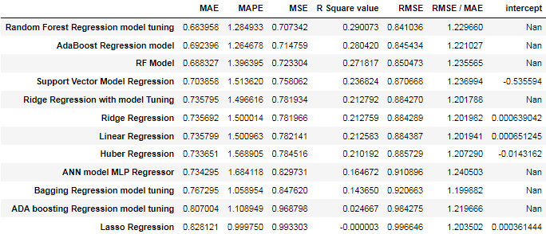
Modeling approach used & why
The most optimum model is Random Forest Regressor using hyper parameters model tuning gives the best values among the other Hyper tuning model. The score of the model is the highest among all the models.
The Mean squared error are the least when compared to other models and all the performance metrics are within optimum limits.
So, after observing all these points we can conclude that the Random Forest Regressor using hyper parameters model tuning is the most optimum model.

Slide 17
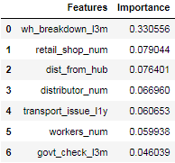
Modeling approach used & why
Top 7 Important Feature Selection from the best model for this dataset are:

Slide 18
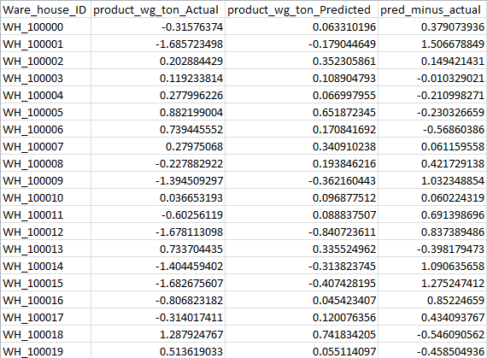
Insights & recommendation
From this we can predict that supply and demand can be optimized based on this value.

Slide 19
Insights & recommendation
By understanding the demand and supply, we can optimize the warehouse storage and operations.
Inventory can be managed based on the optimization of warehouse details.
Transportation cost can be minimized.
Supply of goods can be time delay.
Better collaboration with suppliers.
Better quality control.
Shipping optimisation.
Reduced inventory and overhead costs.
Improved risk mitigation.
Stronger cash flow.
A more agile business.
Better visibility and data analytics.

Slide 20
Thank You

